Slide 1
Classification: Basics and Decision Trees

Slide 2
In this lecture you will
Classification
Understand what a classification problem is (and could be)
Define formalized learning
Understand how a loss function is used during model training
Decision Trees
Understand how a decision tree can be used for many classification tasks
Understand how a decision tree model can be trained from data
Understand how model performance can be measured
In-class coding examples:
Prepare a dataset for training
Train a DecisionTreeClassifier
Measure the classifier accuracy

Slide 3
Review: what is supervised machine learning?
We are trying to predict a labelled target [i.e. is this a picture of a RBC or a WBC?]
We hypothesize that there is a relationship between the target and the data available [i.e. RBC are smooth circles/ovals with a dip in their centers, while WBCs have irregular borders and nuclei]
We train a classification model to detect this pattern/relationship in the data [the model learns the relationship through training]
The trained model can be used to predict new, unseen images [the model generalizes, ideally]

Slide 4
Types of classification: binary classification
Predict whether this student will pass or fail the course
Predict if this image is a RBC or WBC
Predict if this image is of me, or not
Predict if this Amazon review is fake or not
Other examples?
What is the target?
What is the hypothesized relationship?
What does the dataset look like? How do we get it?

Slide 5
Types of classification: multi-class classification
Predict what major this student is
How about predicting their grade in the course?
Predict what kind of WBC this image is [i.e. monocyte, lymphocyte, neutrophils, etc.]
Predict who this is an image of, given several known targets
Predict what product type this Amazon review is discussing
How about predict the number of stars from the review itself?
Other examples?
What is the target?
What is the hypothesized relationship?
What does the dataset look like? How do we get it?

Slide 6
Classification versus regression
In classification problems, we are dealing with discrete values as targets
In regression problems, we are dealing with continuous values as targets
Predicting a student’s grade: is this classification, or regression?
If you model a regression problem as classification, you’re typically losing information that could help you get higher performance

Slide 7
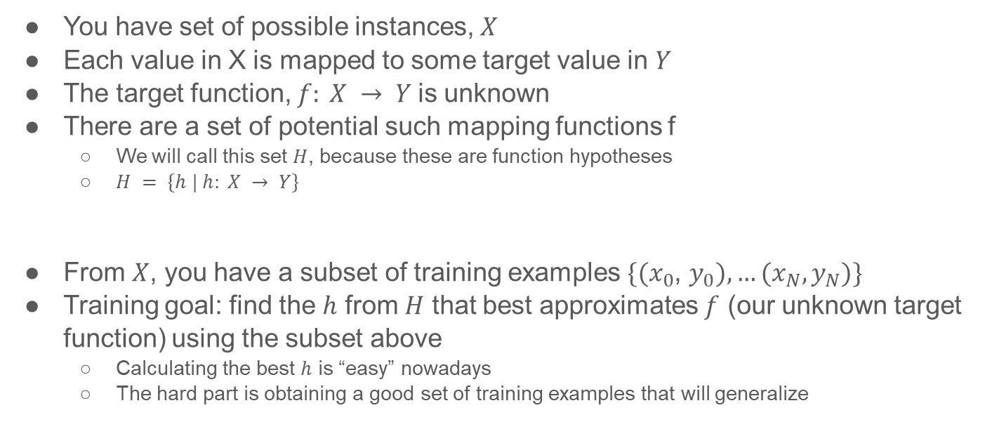
Formal notation: Training as approximating a function
You have set of possible instances, $X$
Each value in X is mapped to some target value in $Y$
The target function, $f: X → Y$is unknown
There are a set of potential such mapping functions f
We will call this set $H$, because these are function hypotheses
$H = \{h | h: X → Y\}$
From $X$, you have a subset of training examples $\{(x_{0}$, $y_{0}), …(x_{N}, y_{N})\}$
Training goal: find the $h$ from $H$ that best approximates $f$ (our unknown target function) using the subset above
Calculating the best $h$ is “easy” nowadays
The hard part is obtaining a good set of training examples that will generalize

Slide 8
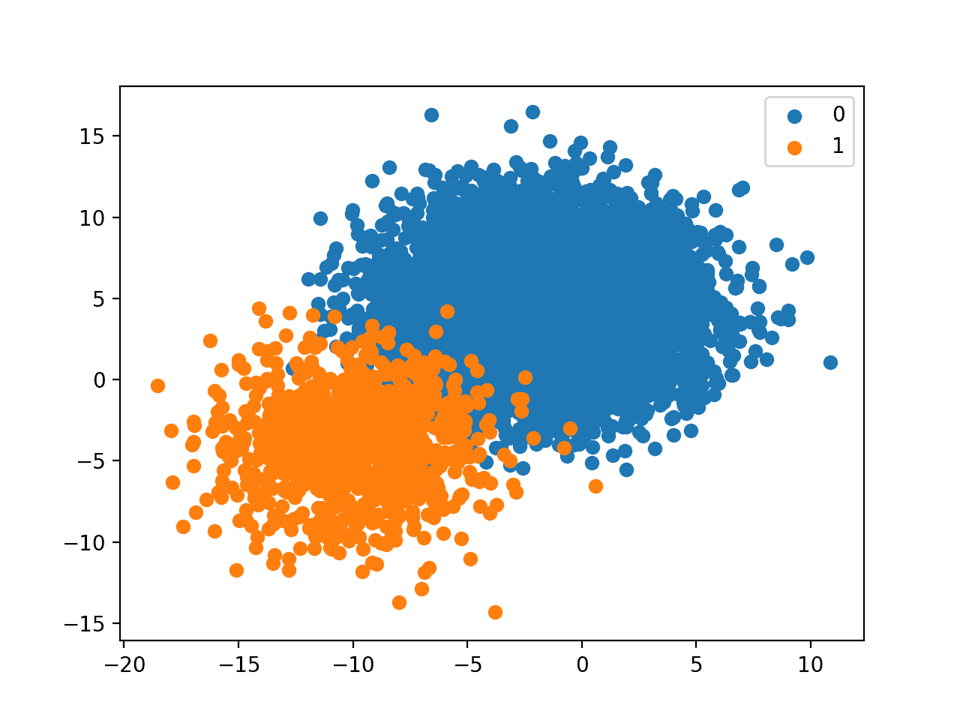
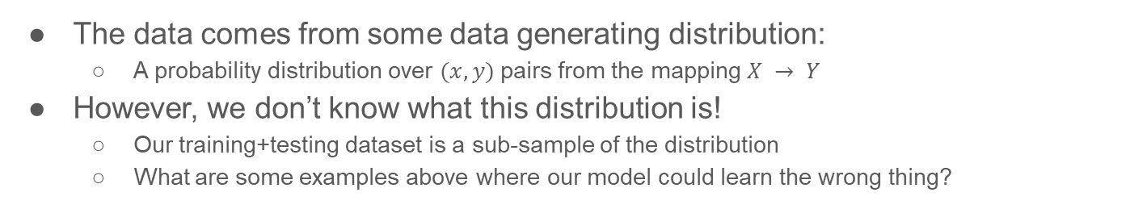
The Data Distribution
The data comes from some data generating distribution:
A probability distribution over $(x, y)$pairs from the mapping $X → Y$
However, we don’t know what this distribution is!
Our training+testing dataset is a sub-sample of the distribution
What are some examples above where our model could learn the wrong thing?

Slide 9
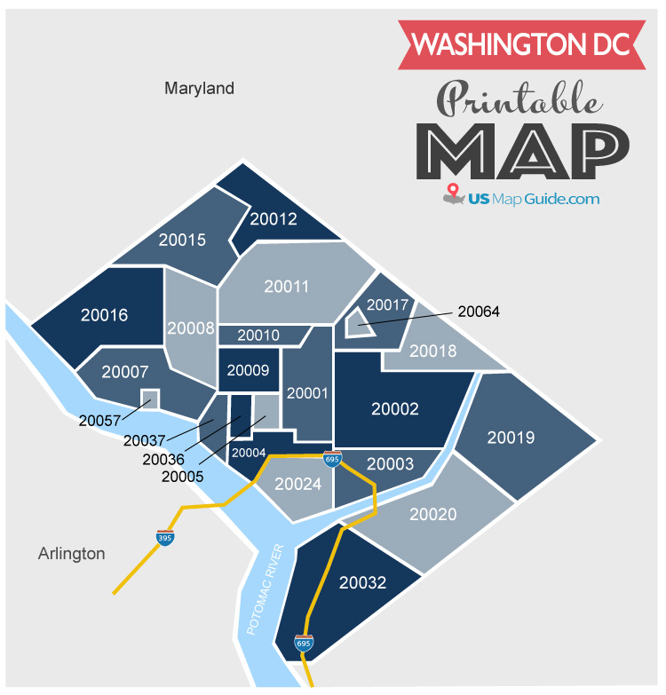
In-class exercise in groups of 2-3 students [5 minutes]
Imagine we want to predict what zipcode a home belongs to in the DC metro area
Classification target: the almost two dozen DC zipcodes to the right
Task 1: come up with a list of home features you could use to build this model [2.5 minutes]
Task 2: what rules/heuristics would make sense for your model to use? [2.5 minutes]
For example, a dwelling with a larger square footage is more likely to be in zipcode 20016

Slide 10
In-class exercise in groups of 2-3 students [3 minutes]
How would you calculate the error of your model?

Slide 11
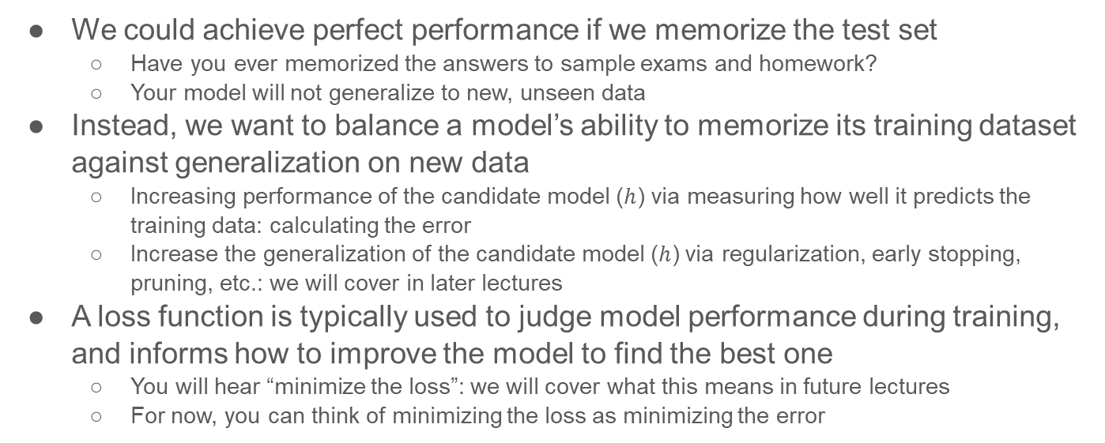
How to find the best function mapping $h$?
We could achieve perfect performance if we memorize the test set
Have you ever memorized the answers to sample exams and homework?
Your model will not generalize to new, unseen data
Instead, we want to balance a model’s ability to memorize its training dataset against generalization on new data
Increasing performance of the candidate model ($h$) via measuring how well it predicts the training data: calculating the error
Increase the generalization of the candidate model ($h$) via regularization, early stopping, pruning, etc.: we will cover in later lectures
A loss function is typically used to judge model performance during training, and informs how to improve the model to find the best one
You will hear “minimize the loss”: we will cover what this means in future lectures
For now, you can think of minimizing the loss as minimizing the error

Slide 12
In-class exercise in groups of 2-3 students [3 minutes]
Imagine you were now trying to iterate on your existing model
You can change how much weight you give to a certain feature
You can add or remove features
How do you know if the changes you are making are helping or hurting your model?
How do you decide what changes to make in the next round of training?

Slide 13
Example penalties for our zipcode calculator
We could have a very simple model that uses the price per square foot, mostly ignoring all the other home features, to predict the zipcode
To measure the error of this model, we can see how often it predicts the correct zipcode
To calculate the loss during training, we could have a loss function that penalizes all models that put too much emphasis on a single feature, in addition to measuring the error
Our model above will have a very large loss, and in training would be guided towards using more of the available features so its loss can be reduced, i.e. “is there another way you could get such a low error, but by using more of the home features?”
Using a different or customized loss function is a potential way to significantly improve your models

Slide 14
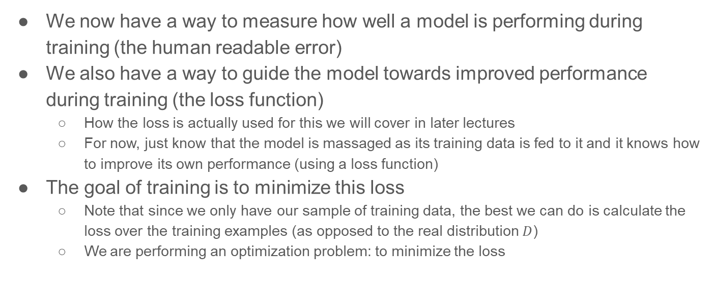
Training a model
We now have a way to measure how well a model is performing during training (the human readable error)
We also have a way to guide the model towards improved performance during training (the loss function)
How the loss is actually used for this we will cover in later lectures
For now, just know that the model is massaged as its training data is fed to it and it knows how to improve its own performance (using a loss function)
The goal of training is to minimize this loss
Note that since we only have our sample of training data, the best we can do is calculate the loss over the training examples (as opposed to the real distribution $D$)
We are performing an optimization problem: to minimize the loss

Slide 15
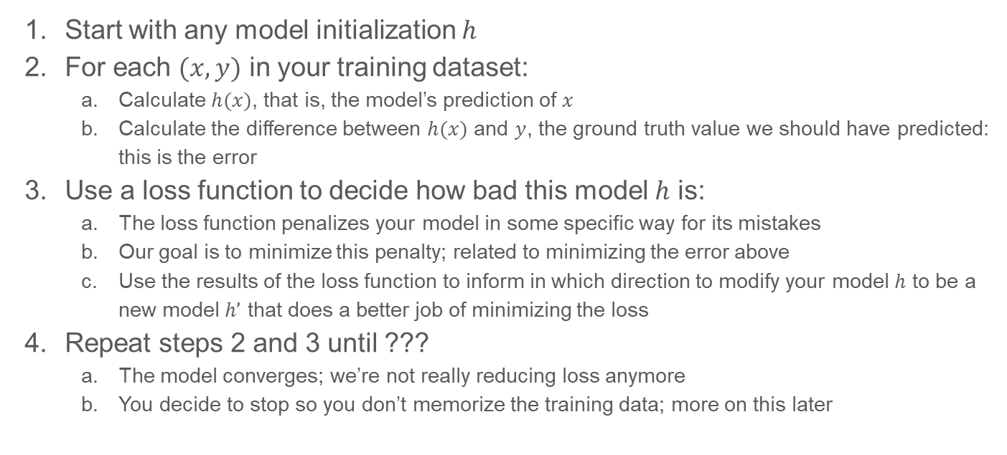
How to train a model
Start with any model initialization $h$
For each $(x,y)$ in your training dataset:
Calculate $h(x)$, that is, the model’s prediction of $x$
Calculate the difference between $h(x)$ and $y$, the ground truth value we should have predicted: this is the error
Use a loss function to decide how bad this model $h$ is:
The loss function penalizes your model in some specific way for its mistakes
Our goal is to minimize this penalty; related to minimizing the error above
Use the results of the loss function to inform in which direction to modify your model $h$ to be a new model $h’$ that does a better job of minimizing the loss
Repeat steps 2 and 3 until ???
The model converges; we’re not really reducing loss anymore
You decide to stop so you don’t memorize the training data; more on this later

Slide 16
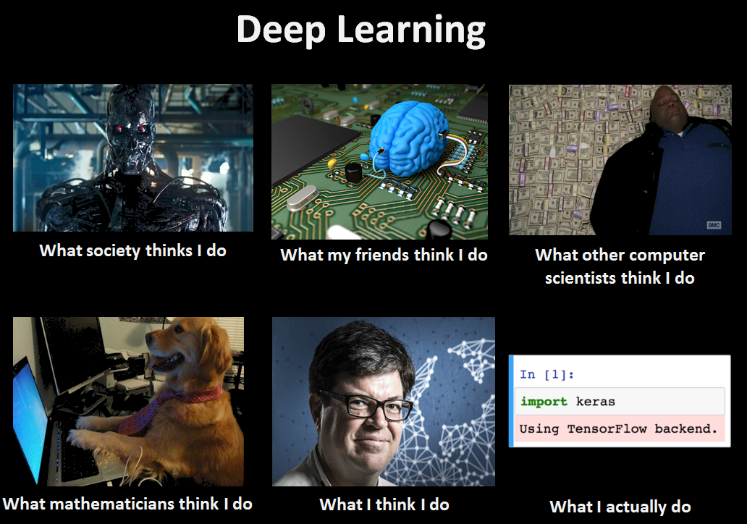
What does this look like in code?
Training a model is often just a single line of code (as we’ll see today), or a few lines of code (later this semester)
Many libraries are written to take care of the low-level details
However, it’s important you understand (at least at a high level) how these models work under-the-hood

Slide 17
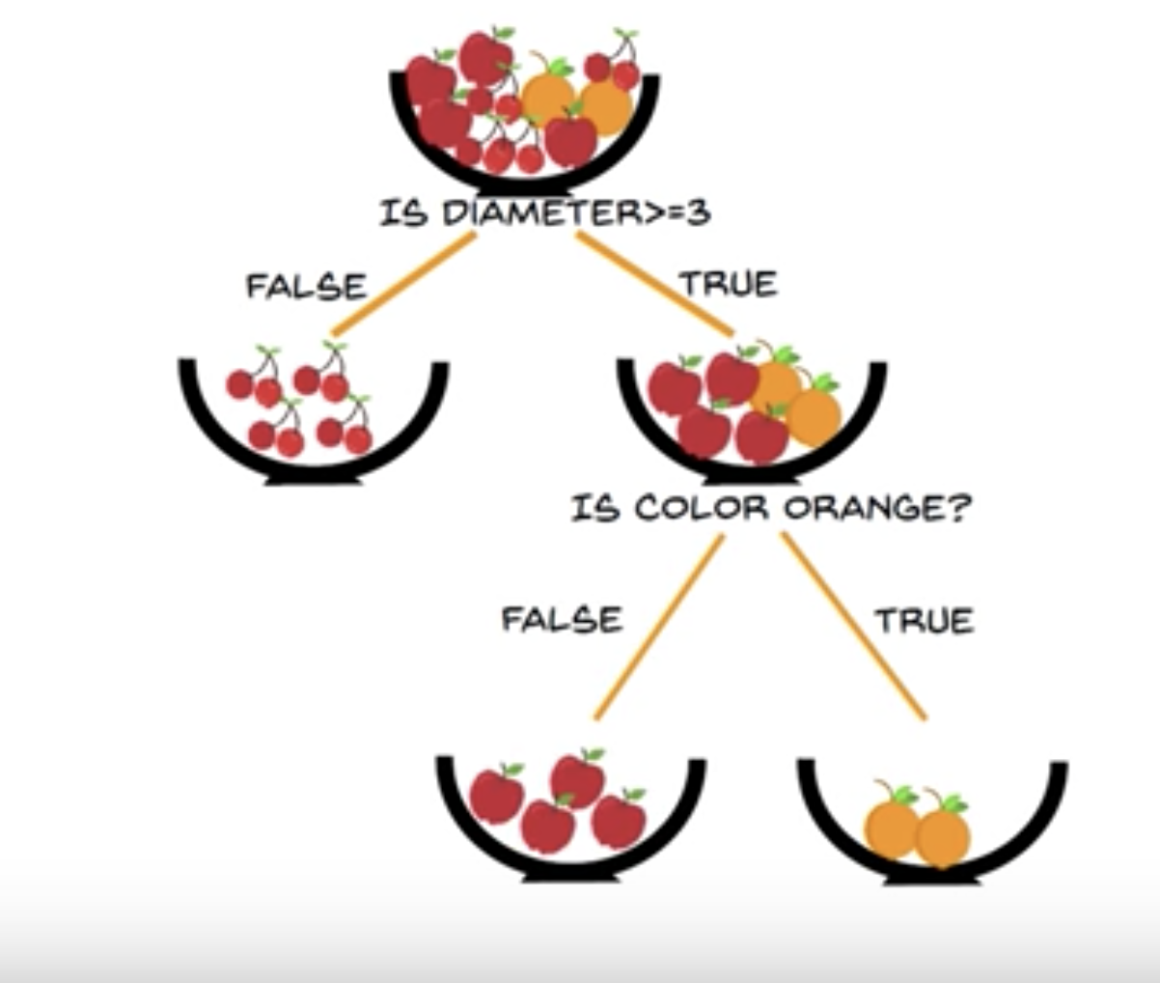
Our first model: a Decision Tree
We can use a decision tree to make predictions
For example, to classify a fruit based on its diameter and color
It works just like a flowchart
Internal nodes test features
Leaf nodes are a classification
How do you learn the shape of the tree though? How can you train such a model from a dataset?
We’ll go over that in a little bit

Slide 18
Let’s see how we could train a model on real data
Obtain a good dataset
Split the dataset into training and holdout data
Choose a classifier
Train a classifier
Make predictions and measure the classifier accuracy

Slide 19
Step 1: Obtain a good dataset
Spoiler alert: you will probably fail to get a good dataset…
We could spend a whole semester discussing this
For now, let’s just worry about obtaining a dataset that our model can handle
We’ll stick with tabular data for the first part of this semester
Later, we’ll do some computer vision problems (images) with deep learning models
Later, we’ll explore Natural Language Processing (NLP) on human-readable text
The models we will use the first part of the semester will require that all of the input features be numeric
Actually, all models require this in some sense, but often the conversion is handled for you
There’s a saying that data scientists spend most of their time cleaning and curating their datasets
Welcome to your homework problems and interview coding projects :-)

Slide 20
Step 1: Obtain a good dataset
Let’s work with this dataset on student features: https://archive.ics.uci.edu/ml/datasets/Student+Performance
Let’s open the tabular data and do a little bit of exploration in python:
Note: there is a whole world of Jupyter Notebooks out there and ways to make beautiful graphs: we will not focus on teaching these this semester, but feel free to explore
import pandas
dataframe = pandas.read_csv('student-mat.csv')
print(dataframe.head())
for c in dataframe.columns:
print(c)
print(dataframe[c].value_counts(dropna=False))
print(dataframe.columns)

Slide 21
Let’s see how we could train a model on real data
Obtain a good dataset
Split the dataset into training and holdout data
Choose a classifier
Train a classifier
Make predictions and measure the classifier accuracy

Slide 22
Step 2: Split the data into training and holdout
Again, we could spend a whole lecture on this…(and we will)
The holdout set is used to measure how well your model might perform on unseen data, after you’ve finished training
For situations where you are going to tune your model, people often have a training, validation/test, and holdout sets
What do you do if you have very little data?
The split should be random in most cases
If your data has samples that are related to one another, be careful about how you split
For example, if you have multiple medical images coming from the same patient, don’t split a single patient across train and holdout

Slide 23
Step 2: Split the data into training and holdout
In Python for tabular data, the splitting can be done with the code below
For now, we are removing all non-numeric columns, but later we’ll handle them
from sklearn.model_selection import train_test_split
target = 'internet'
y = dataframe[target]
non_numeric = ['school', 'sex', 'address', 'famsize', 'Pstatus', 'Mjob',
'Fjob', 'reason', 'guardian']
X = dataframe.drop(labels = non_numeric+[target], axis='columns')
X_train, X_test, y_train, y_test = train_test_split(X, y, test_size=0.2)

Slide 24
Let’s see how we could train a model on real data
Obtain a good dataset
Split the dataset into training and holdout data
Choose a classifier
Train a classifier
Make predictions and measure the classifier accuracy

Slide 25
Step 3: Choosing a classifier
We are essentially spending the whole semester:
Talking about how to choose a classifier
Talking about how to set the parameters effectively for a classifier
If you have the resources, you can always try multiple models
Most of the time, you will also want to tune the model type of you end up settling on -- more on that later
In Python, choosing a classifier is simple:
However, you can also specify parameters (such as the loss function) at this point in the constructor call
from sklearn import tree
classifier_model = tree.DecisionTreeClassifier()

Slide 26
Let’s see how we could train a model on real data
Obtain a good dataset
Split the dataset into training and holdout data
Choose a classifier
Train a classifier
Make predictions and measure the classifier accuracy

Slide 27
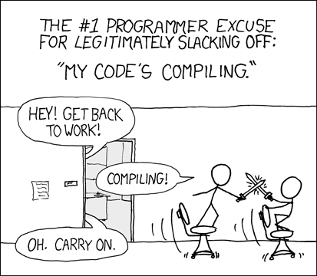
Step 4: training the classifier
This step can be computationally expensive
A second or two for us today on our small dataset, but could take days (or longer) on even moderate-sized image datasets being used to train neural nets on a GPU
For more complex models, there are many options, but for our tabular data in Python we can do:
classifier_model = classifier_model.fit(X_train, y_train)

Slide 28
Let’s see how we could train a model on real data
Obtain a good dataset
Split the dataset into training and holdout data
Choose a classifier
Train a classifier
Make predictions and measure the classifier accuracy

Slide 29
Step 5: Make predictions and measure performance
Again, how to measure performance is tricky
We’ll use raw accuracy today, but there are reasons to use precision and recall, weighted metrics, confusion matrices, etc.
Typically, we not only want to see good performance, but we want to understand how the model made its decisions (and why)
There is an entire sub-field around ML model explainability…

Slide 30
Step 5: Make predictions and measure performance
In Python, on our tabular data we can get insights into our model performance with:
from sklearn.tree import export_text
from sklearn.metrics import accuracy_score
view_tree = export_text(classifier_model, feature_names=list(X.columns))
print(view_tree)
predictions = classifier_model.predict(X_test)
print(predictions)
print(accuracy_score(y_test, predictions))
See the paper at: http://www3.dsi.uminho.pt/pcortez/student.pdf

Slide 31
Homework 1: In-class exercise in groups of 2-3 students [rest of class]
Download the dataset
Replace all yes with 1 and no with 0 in the csv (use replace-all)
Split the data, train your model, test your model
Modify your code to predict a different [binary] target
Complete the following homework day before next class (submit to BB):
https://www2.seas.gwu.edu/~kinga/CS4364_S22/homeworks/Homework1.html
Only one group member needs to submit the assignment -- make sure all your names are on that submission

Slide 32
Summary of today’s lecture
Classification
Understand what a classification problem is (and could be)
Define formalized learning
Understand how a loss function is used during model training
Decision Trees
Understand how a decision tree can be used for many classification tasks
Understand how a decision tree model can be trained from data
Understand how model performance can be measured
In-class coding examples:
Prepare a dataset for training
Train a DecisionTreeClassifier
Measure the classifier accuracy

